Slide 1
The Rationale for Testing
Why do we test? What are the underlying principles of testing?

Slide 2
Testing in the 21st Century
Software defines behavior
network routers, finance, switching networks, other infrastructure
Today’s software market :
is much bigger
is more competitive
has more users
Embedded Control Applications
airplanes, air traffic control
spaceships
phones
ovens
remote controls
Agile processes put increased pressure on testers
Programmers must unit test – with no training or education!
Tests are key to functional requirements – but who builds those tests ?
Industry is going through a revolution in what testing means to the success of software products
cars (Tesla autopilot)
smart watches
IoT devices (Nest thermostats)
home security

Slide 3
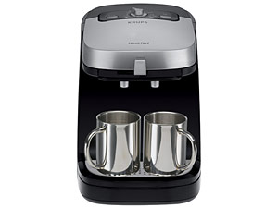

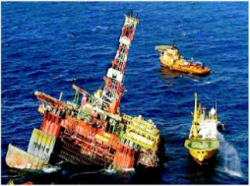
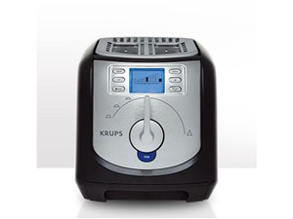

Software is a Skin that Surrounds Our Civilization
Quote by Dr. Mark Harman

Slide 4
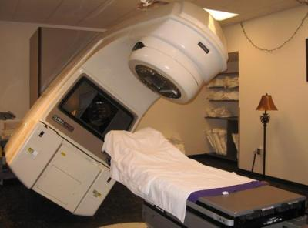
Therac-25 (1985-1987)
Therac-25: first dual treatment mode radiation therapy machine
Hardware-based safety measures replaced by software-based ones
Race condition:
UI reported safe levels of radiation to be delivered in error.
Actual delivery: 100x the expected dose
Bug was in previous code base, but was overridden by hardware controls
Resulted in at least 3 deaths, 3 debilitating injuries
Byte overflow:
Setup verification used a byte variable Class3: 0 ==okay, !0==adjustment needed
Each setup verification step: ++class3
256th verification roll over to zero
Resulted in at least one serious injury
Follow-up showed no test plan, no independent verification

Slide 5

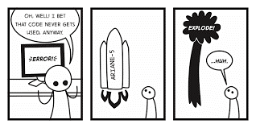
Ariane 5 (6/4/1996)
37 seconds into maiden flight flips 90 degrees, tears apart, self-destructs
Problem traced to:
The value of a 64-bit floating-point variable being stuffed into a 16-bit integer, and,
A value produced by the processor for debugging was mistaken for flight data.
Code from Ariane 4 was removed for perf
Result:
Loss of $370,000,000
Scientific study of magnetosphere delayed 4 years.

Slide 6


Mars Climate Orbiter (9/23/1999)
Experienced a “rapid unanticipated disassembly” on approach to Mars
Why?
Unanticipated impact of solar radiation put vehicle off intended trajectory
Imperial (Lockheed) v. metric (NASA) units used by ground control
Result:
Vehicle burned up in the Martian atmosphere
$235m lost
Loss of communications relay for the Mars Polar Lander
Sure, we’ll use newton-seconds!
Let’s use pound-seconds!

Slide 7

Northeast Blackout of 2003
508 generating units and 256 power plants shut down
Affected 10 million people in Ontario, Canada
Affected 40 million people in 8 US states
Financial losses of
$6 Billion USD
The alarm system in the energy management system failed due to a software error and operators were not informed of the power overload in the system

Slide 8

The Knight Capital Group debacle (8/1/2012)
Program trading nightmare: code installed on one server:
Includes an algorithm mistakenly buys at bid price and sells at ask price, thus losing a few cents on each transaction…
…as fast as it can.
What happened?
“Power Peg” was an algorithm to be used by QA to drive up stock price.
A switch to turn on Power Peg was erroneously repurposed. When deployed, the server thought it was in a test environment.
Power Peg was actually outdated code that should have been removed; safety checks had been inadvertently removed 7 years earlier.
The result: 4 million trades with a loss of $460,000,000.
No formal review process, no devops controls.

Slide 9
Other failures of note…
2011: California releases 450 violent felons from prison due to software error. Many felons still remain free.
2012: Apple Maps is released with missing towns, incorrect placed locations, obscured satellite imagery, etc.
2015: Starbucks “routine refresh” causes register malfunction forcing 60% of US and Canada stores to close.
2016: Nest thermostat firmware update leaves customers unable to hear their homes on one of the coldest weekends of the year
2017: AWS goes down for four hours. In 2016, when it went down for 20 minutes on a smaller number of sites, the outage cost Amazon $3.75m

Slide 10
Can you think of others?

Slide 11
Software Failures: Pervasive and Costly
NIST report, “The Economic Impacts of Inadequate Infrastructure for Software Testing” (2002)
Inadequate software testing costs the US alone between $22 and $59 billion annually
Better approaches could cut this amount in half
Huge losses due to web application failures
Financial services : $6.5 million per hour (just in USA!)
Credit card sales applications : $2.4 million per hour (in USA)
People expect software to be dependable.
Proper testing is one way to assess dependability.

Slide 12
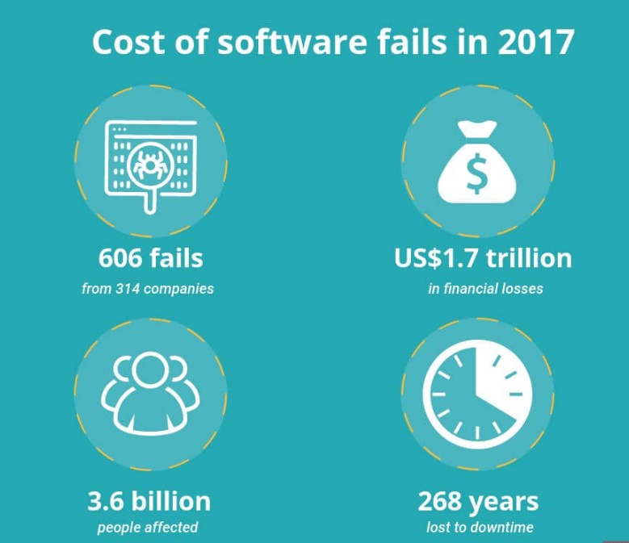
Updated (but maybe less reliable)
“Cost of Software Errors: How Much Could Software Errors Be Costing Your Company?” Raygun, Raygun, 22 Mar. 2017,

Slide 13
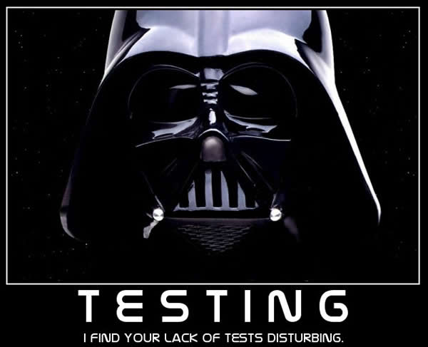

Slide 14
Modern Systems Require Modern Testing
More safety critical, real-time software
Embedded software is ubiquitous
Enterprise applications means bigger programs, more users
Security is now all about software faults
Secure software is reliable software
The web as a deployment platform adds a new wrinkle
Very competitive and very available to more users
Web apps are distributed
Web apps must be highly reliable
Testing tools and techniques must continue to evolve

Slide 15
What does this all mean?
Software testing is becoming
even more important
What are we trying to do when we test ?
What are our goals ?

Slide 16
Validation & Verification (IEEE-STD-610)
Validation: The process of evaluating software at the end of software development to ensure compliance with intended usage
Verification: The process of determining whether the products of a given phase of the software development process fulfill the requirements established during the previous phase
IV&V: “independent verification and validation”

Slide 17
Testing Goals Based on Test Process Maturity Derived from SEI Capability Maturity Model
Level 0: There’s no difference between testing and debugging
Level 1: The purpose of testing is to show correctness
Level 2: The purpose of testing is to show that the software doesn’t work
Level 3: The purpose of testing is not to prove anything specific, but to reduce the risk of using the software
Level 4: Testing is a mental discipline that helps all IT professionals develop higher quality software

Slide 18
Level 0 Thinking
Testing is the same as debugging
Does not distinguish between incorrect behavior and mistakes in the program
Does not help develop software that is reliable or safe

Slide 19
Level 1 Thinking
Purpose is to show correctness
…but “correctness” is impossible to determine
What do we know if no failures?
Good software or bad tests?
Test engineers have no:
Strict goal
Real stopping rule
Formal test technique
Test managers are powerless

Slide 20
Level 2 Thinking
Purpose is to show failures
Looking for failures is a negative activity
Puts testers and developers into an adversarial relationship
What if there are no failures?
This describes most software companies.

Slide 21
Level 3 Thinking
Testing can only show the presence of failures
Whenever we use software, we incur some risk
Risk may be small and consequences unimportant
Risk may be great and consequences catastrophic
Testers and developers cooperate to reduce risk
This describes a few “enlightened” software companies

Slide 22
Level 4 Thinking
A mental discipline that increases quality
Testing is only one way to increase quality
Test engineers can become technical leaders of the project
Primary responsibility to measure and improve software quality
Testers’ expertise should help developers
This is the way “traditional” engineering works

Slide 23
Tactical Goals : Why Each Test ?
Written test objectives and requirements must be documented.
What is each test trying to determine?
What are your planned coverage levels?
How much testing is enough – the definition of done for testing.
Old school – test until it’s time to ship

Slide 24
Why Each Test ?
If you don’t start planning for each test when the functional requirements are formed, you’ll never know why you’re conducting the test
What are the threshold reliability requirements?
What fact does each test try to verify?
Requirements definition teams should include testers

Slide 25
Bottom Line: Testing is Expensive...
But not testing is even more expensive
Testing is the most time consuming and expensive part of software development
Inadequate testing can lead to tremendous losses
If we have too little testing effort early, the cost of testing increases
Planning for testing after development is prohibitively expensive

Slide 26
The ISTQB Error Taxonomy
Error: A human action that produces an incorrect result. Syn: mistake
Defect: An imperfection or deficiency in a work product where it does not meet its requirements or specifications. Syn: fault, bug
Failure: An event in which a component or system does not perform a required function within specified limits. Syn: unexpected result, crash, system go “boom”
There are similar anomaly taxonomies offered by IEEE and ISO, but we’ll use these ISTQB definitions.

Slide 27
Defects in software are equivalent to design mistakes in hardware.
Software does not degrade.

Slide 28
A Concrete Example
Fault: Should start searching at 0, not 1
public static int CountZero (int[] array)
{
//If array is null, throw NullPointerException,
//else return the number of occurrences of 0 in array
int count = 0;
for(int i = 1; i < array.Length; i++)
{
if(array[i] == 0)
{
count++;
}
}
return count;
}
Test 1
[ 2, 7, 0 ]
Expected: 1
Actual: 1
Result of the fault: i is 1, not 0, on the first iteration
Failure: none
Test 2
[ 0, 2, 7 ]
Expected: 1
Actual: 0
Result of the fault: i is 1, not 0
i propagates to the variable count
Failure: count is 0 at the return statement

Slide 29


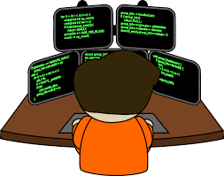
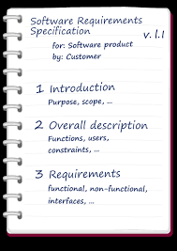
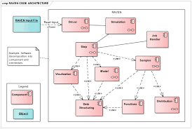
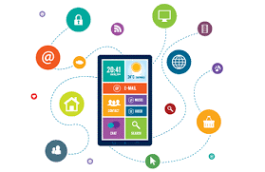
How defects are introduced
Designer
Analyst
Developer
Requirements
Specification
App Design
Software

Slide 30



How defects are introduced
Designer
Analyst
Developer
Defect
Defect
Defect
Requirements
Specification
App Design
Software

Slide 31
Finding defects late is expensive
Cost to repair
Notes:
28-Oct-2010, at GTAC, added the animation to demonstrate increasing the number of faults found early, thereby decreasing the number of faults found late, and finally saving money. Lots of it! This animation is fairly complicated … must practice first!!

Slide 32
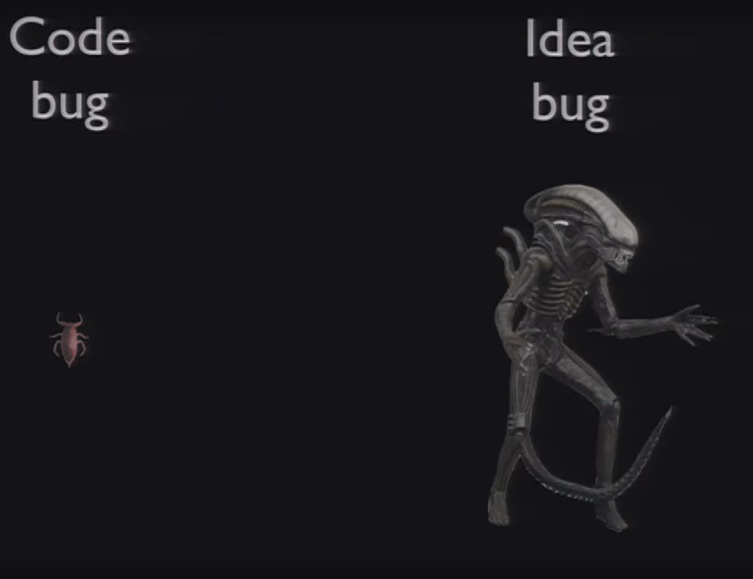

GTAC 2011: Opening Keynote Address - Test is Dead presented by Albert Savoia

Slide 33
Aside: Defects in a test basis v. executing code
Test basis: the documents from which the requirements of a system can be inferred, e.g.:
Use cases and user stories
UX designs
Functional specs
Design docs
Test bases can have defects that impact implementation in the form of:
Inaccuracies
Ambiguities
Omissions
Inconsistencies
Contradictions
Superfluous statements

Slide 34
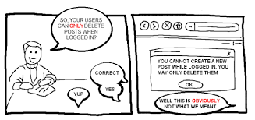
Ambiguity woes

Slide 35

How testing affects quality
Testing can reduce the risk of failure
Testing can be applied throughout the life cycle
Correcting defects increases quality and lowers risk (of course)
System quality can be inferred from test-related metrics:
Frequency of defect discovery
Number of discovered defects
Extent of test coverage
Percentage of tests passing
These data can be used to improve processes to avoid defect introduction in future.

Slide 36
Testing as Defined by ISTQB
The process consisting of all lifecycle activities, both static and dynamic, concerned with planning, preparation and evaluation of software products and related work products to determine that they satisfy specified requirements, to demonstrate that they are fit for purpose and to detect defects.

Slide 37
Thus, Testing is More than Test Execution
Test
Planning
Report results
Design
Tests
Test Execution
Verify user needs are met
Implement
Tests
Assess
Overall Quality
. . .

Slide 38
Core Software Testing Roles
Tester : An IT professional who is in charge of one or more technical test activities
Designing test inputs
Producing test values
Running test scripts
Analyzing results
Reporting results to developers and managers
Test Manager : In charge of one or more test engineers
Sets test policies and processes
Interacts with other managers on the project
Otherwise supports the engineers
Software companies often distinguish between:
Software Test Engineers (STEs)
Software Development Engineers in Test (SDETs)
Microsoft terms

Slide 39
Software Testing Roles
Test management : Sets policy, organizes team, interfaces with development, chooses criteria, decides how much automation is needed, …
Test maintenance : Save tests for reuse as software evolves
Requires cooperation of test designers and automators
Deciding when to trim the test suite is partly policy and partly technical – and in general, very hard !
Tests should be put in configuration control
Test documentation : All parties participate
Each test must document “why” – criterion and test requirement satisfied or a rationale for human-designed tests
Ensure traceability throughout the process
Keep documentation in the automated tests

Slide 40
Complexity of Testing Software
No other engineering field builds products as complicated as software
The term correctness has no meaning
Is a building correct?
Is a car correct?
Is a subway system correct?
Like other engineers, testers must use abstraction to manage complexity
This is the purpose of the model-driven test design process
The “model” is an abstract structure

Slide 41
At the Core of the Test Discipline: Testing and Debugging
Testing : Evaluating software by observing its execution
Test Failure : Execution of a test that results in a software failure
Debugging : The process of finding a fault given a failure
Not all inputs will “trigger” a fault into causing a failure

Slide 42
Fault (defect) & Failure Model (RIPR)*
Four conditions necessary for a failure to be observed
Reachability : The location or locations in the program that contain the fault must be reached
Infection : The state of the program must be incorrect
Propagation : The infected state must cause some output or final state of the program to be incorrect
Reveal : The tester must observe part of the incorrect portion of the program state
Coined by the Ammann and Offutt. It’s not in general use but is still effective.

Slide 43

RIPR Model
Reachability
Infection
Propagation
Revealability
Test
Final Program State
Reaches
Incorrect Final State
Observed Final Program State
Defect
Infects
Propagates
Incorrect Program State
Reveals
Test Oracle
Tester
Notes:
The failures can be revealed when the observed final program state has overlap with the incorrect final program state.
The question is: should testers check the entire program state? How to observe the incorrect program state in a cost-effective manner.
Getting the overlap as big as possible and the cost as small as possible.

Slide 44
Static and Dynamic Testing
Static testing is the testing of a work product without code being executed, e.g.,
Evaluate user stories
Inspection of design
Automated or manual code inspection
Dynamic testing is testing that involves the execution of the software of a component or system, e.g.,
Unit testing
UI-focused test tools (browser automation, for instance)
System regression tests

Slide 45
Seven Testing Principles see ISTQB Certified Tester Foundation Level Syllabus Version 2018, pp 16-17
Testing shows presence of defects, not their absence
Exhaustive testing is impossible
Early testing saves time and money
Defects cluster together
Beware of the pesticide paradox
Testing is context dependent
Absence-of-errors is a fallacy

Slide 46
The Test Process is Contextual see ISTQB Certified Tester Foundation Level Syllabus Version 2018, pp 16-17
Development lifecycle model/methodologies?
Business domain?
Level of acceptable product and project risk?
Operational constraints (money, time, complexity, contracts, regulations)?
Internal/external standards?

Slide 47
Test Activities per ISTQB
Test planning – What are we doing here?
Test monitoring and control – How are we doing now?
Test analysis - What should we be testing based on the project state?
Test design – How should we test?
Test implementation – Building test environment, procedures, suites
Test execution – Run ‘em
Test completion – Lessons learned, report results, onward and upward

Slide 48
Test Traceability
Each test activity has associated test work products
Each work product should be associated with its test basis

Slide 49
The Tester’s Mindset
Curiosity
Professional pessimism
A critical eye
Attention to detail
Experience
Good communication skills
Successful developers think differently than successful testers.

Slide 50


Psychology of Testing: Different Mindsets
Hi! I’m a tester! I’m here to help!
Developer
Tester
I need to get this routine done! Stay out of my way!
Wait! This software is complex.
I need to figure out what might go wrong!
I know what I’m doing! Get off my back!
There are defects in your code and I’m going to find ‘em, you hack!
Gahhhh!
Gahhhh!
This Photo by Unknown Author is licensed under CC BY

Slide 51
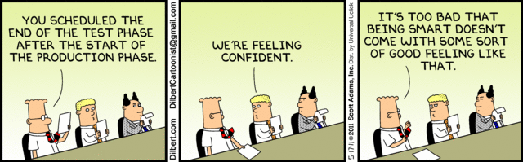
The truth of it: We need testers
Unit testing by a developer tops out at 40 – 50% defect detection effectiveness
Independent test teams score 85% - 98%.

Slide 52
The Rationale for Testing Software
A tester’s goal is to eliminate faults as early as possible
Improve quality
Reduce cost
Maximize customer satisfaction

Slide 53
Reality check
As a point of fact, testers are increasingly being folded into development organizations. The lines are becoming blurred.
“Fail fast” is a popular philosophy. I.e., minimal testing, publish the software, fix it rapidly when problems are found.
The more critical the software, though, the more important formal testing becomes.
Bug in a game? No biggie.
Data loss at a CC company? Biggie.
Online hotel reservations? Not such a big deal.
Passenger airplane avionics? Big, big deal.

